Slide 1

Introduction to Computer Science: Programming Methodology
Tutorial 12
Data structure-STACK AND QUEUE

Slide 2
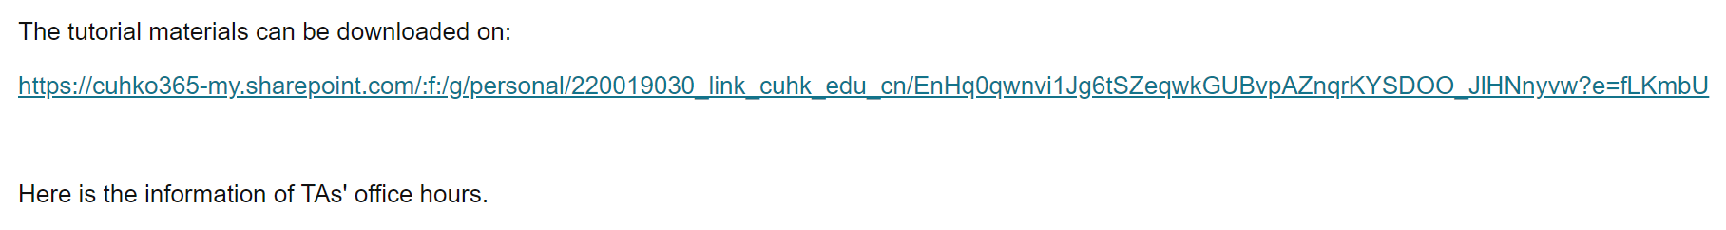
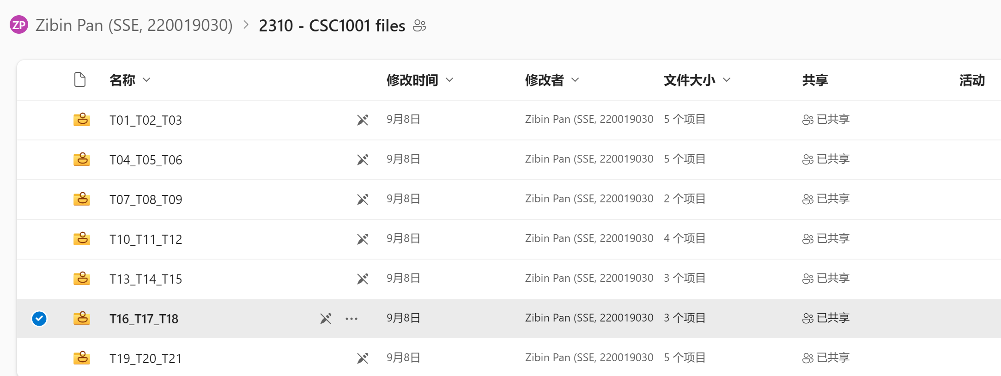
Download this slides and codes at:

Slide 3
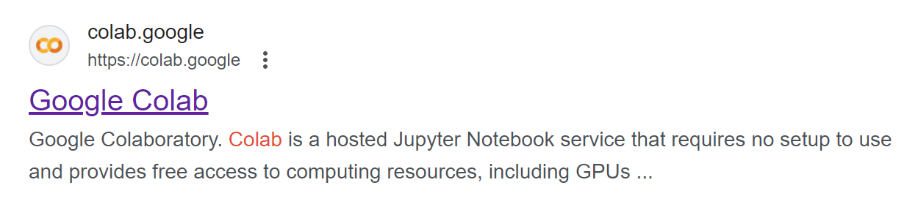
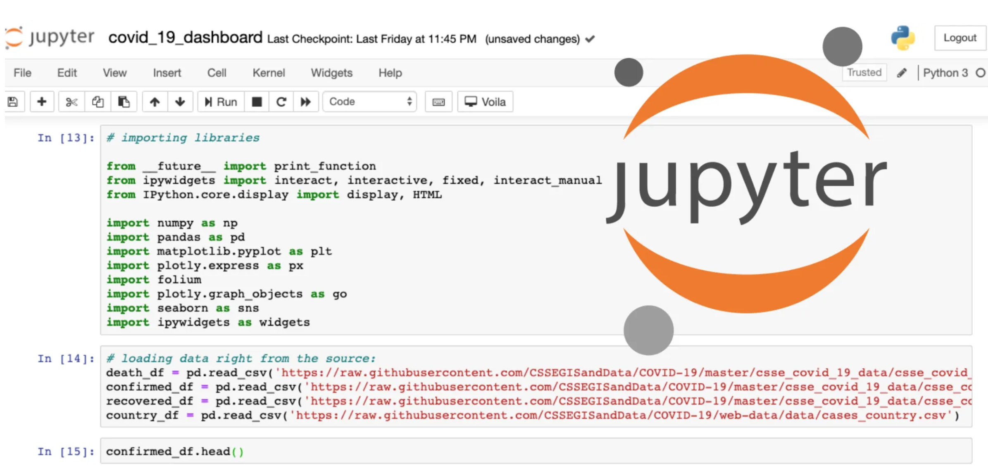
How to use .ipynb file?
Online: Google Colab
Offline: Jupyter Notebook(in Anaconda3)

Slide 4
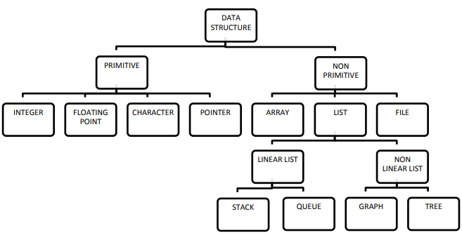
Classification of Data Structure
Data structure is a representation of the logical relationship existing between individual elements of data.
Algorithm + Data Structure=Program
Array stores the same data types.
List can stores a collection of different data types, by storing all of their pointers (pointing towards their addresses), which is very space consuming.

Slide 5
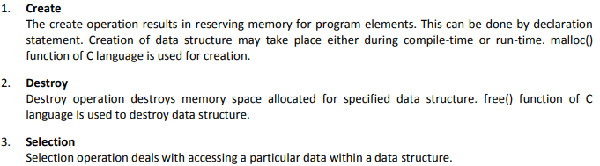

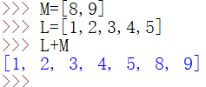

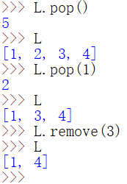
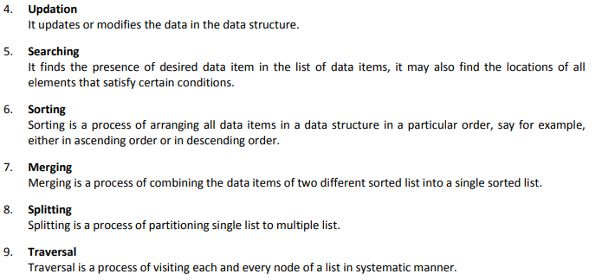





Operations on Data Structure
(Create)
(Merging)
(Destroy)
(Selection)
(Updation)
(Deletion)
(Searching)
(Insertion)
(Sorting)

Slide 6
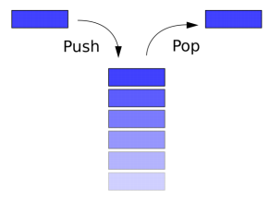
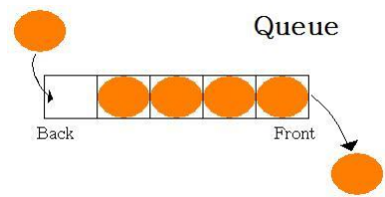
Stack and Queue
Uses of stacks?
Implement recursive algorithms
Compiling and running programs
Backtracking algorithms like constraint satisfaction (e.g. Sudoku(数独))
Uses of queues?
Website requests
Simulations or game engines
Expanding algorithms like Dijkstra’s
https://en.wikipedia.org/wiki/Dijkstra%27s_algorithm

Slide 7

Stack
A stack is a collection of objects that are inserted and removed according to the last-in, first-out (LIFO) principle
A user may insert objects into a stack at any time, but may only access or remove the most recently inserted object that remains (at the so-called “top” of the stack)

Slide 8
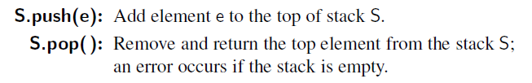
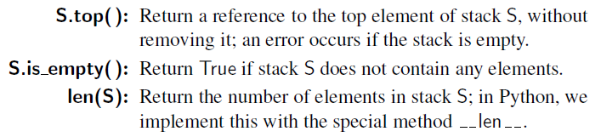
Stack Class
Generally, a stack may contain the following methods:
Refer to the stack.py file for definition of stack class.

Slide 9
Queue
Queue is another fundamental data structure
A queue is a collection of objects that are inserted and removed according to the first-in, first-out (FIFO) principle
Elements can be inserted at any time, but only the element that has been in the queue the longest can be next removed

Slide 10
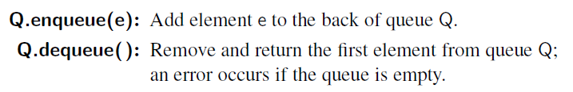
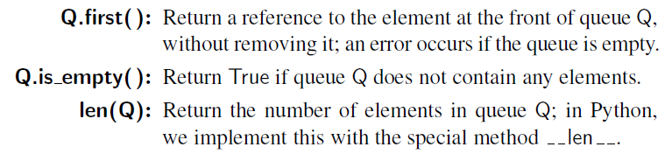
Queue Class
The queue class may contain the following methods:
Refer to the Queue.py file for definition of queue class.

Slide 11
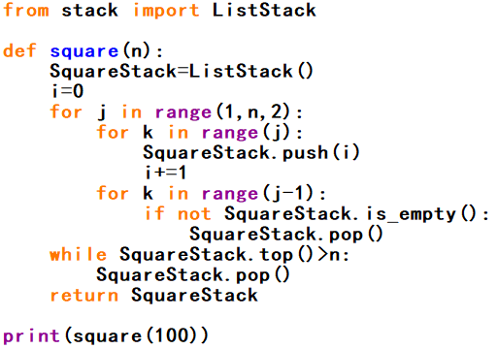
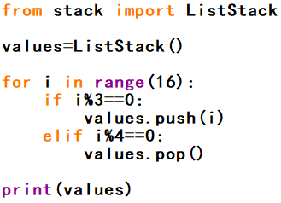
Q1: Create a Stack
What is the outputs of the following programs?
(a)
(b)

Slide 12
Q2: Infix and Postfix-I
Three different notations can be used to represent a mathematical expression. The most common is the traditional algebraic or infix notation where the operator is specified between the operands A+B. The prefix notation places the operator immediately preceding the two operands +AB, whereas in postfix notation, the operator follows the two operands AB+. For example, infix notation (A+B)/(C-D)+E can be changed to postfix one AB+CD-/E+. Please answer the following questions:

Slide 13
Q2: Infix and Postfix-II
i) Translate each of the following expressions into postfix ones:
(a)V*W*(X+Y)-Z (b)X-(Y+W*(Z/V))
(c)A-B*(C+D/E) (d)A/(B*C)-(D+E)
ii) Translate each of the following postfix expressions into infix:
(a)ABC-D*+ (b)XYZ+AB-*-
(c)AB+CD-/E+ (d) AB+C-DE*+
iii) Check the program attached next page, which is to implement translating infix to postfix, and verify your answers in i).

Slide 14
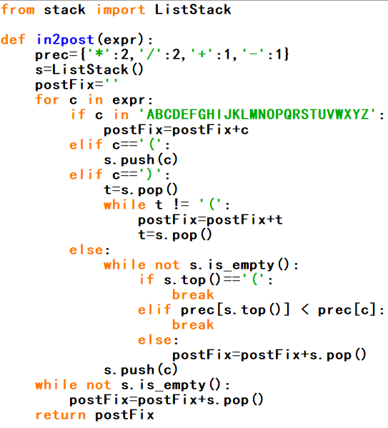
Q2: Infix and Postfix-III
iv) Evaluate the results of expressions in i) with V=1, W=3, X=7, Y=9, Z=10 and A=12, B=4, C=3, D=8, E=2. You can read the next page for instructions. If you like, you can try to write a general function def post2in(expr) to change postfix expressions to infix and verify your answers in ii).

Slide 15
Q2: Infix and Postfix-IV
v) Using postfix is easy to use a stack to evaluate the result of the expression (i.e. replace each letter with actual data). To implement this, you keep pushing the letters and operators in the postfix expression into a stack and whenever you get an operator you pop the previous two expressions and calculate the postfix relative to this operator and push back the result to the stack and move on. Please write a function def evaluate(expr) to first invoke the in2post() to translate the expression expr to postfix and then following the above instructions to calculate the result.

Slide 16

Q3: Find Target In A Stack
Suppose you have a stack S containing n elements and a queue Q that is initially empty. Describe how you can use Q to scan S to see if it contains a certain element x, with the additional constraint that your algorithm must return the elements back to S in their original order. You may only use one stack S and one queue Q.
The stack S before and after the search is printed.

Slide 17
Q4: Queuing Model Simulation-I
We can model a queuing system by constructing a discrete event simulation. The simulation is a sequence of significant events that cause a change in the system. For example, in our airline ticket counter simulation, these events would include customer arrival, the start or conclusion of a transaction, or customer departure. The simulation is time driven and performed over a preset time period. The passing of time is represented by a loop, which increments a discrete time intervals. Thus, the time units must be small enough such that no event can occur between units.

Slide 18
Q4: Queuing Model Simulation-II
A simulation is commonly designed to allow the user to supply parameters that define the conditions of the system. For a discrete event simulation modeling a queuing system, these parameters include:
The length of the simulation given in numbers of time units. The simulation typically begins at time unit zero.
The number of servers providing the services to the customers.
The expected service time to complete a transaction.
The distribution of arrival times, which is used to determine when customers arrive.

Slide 19
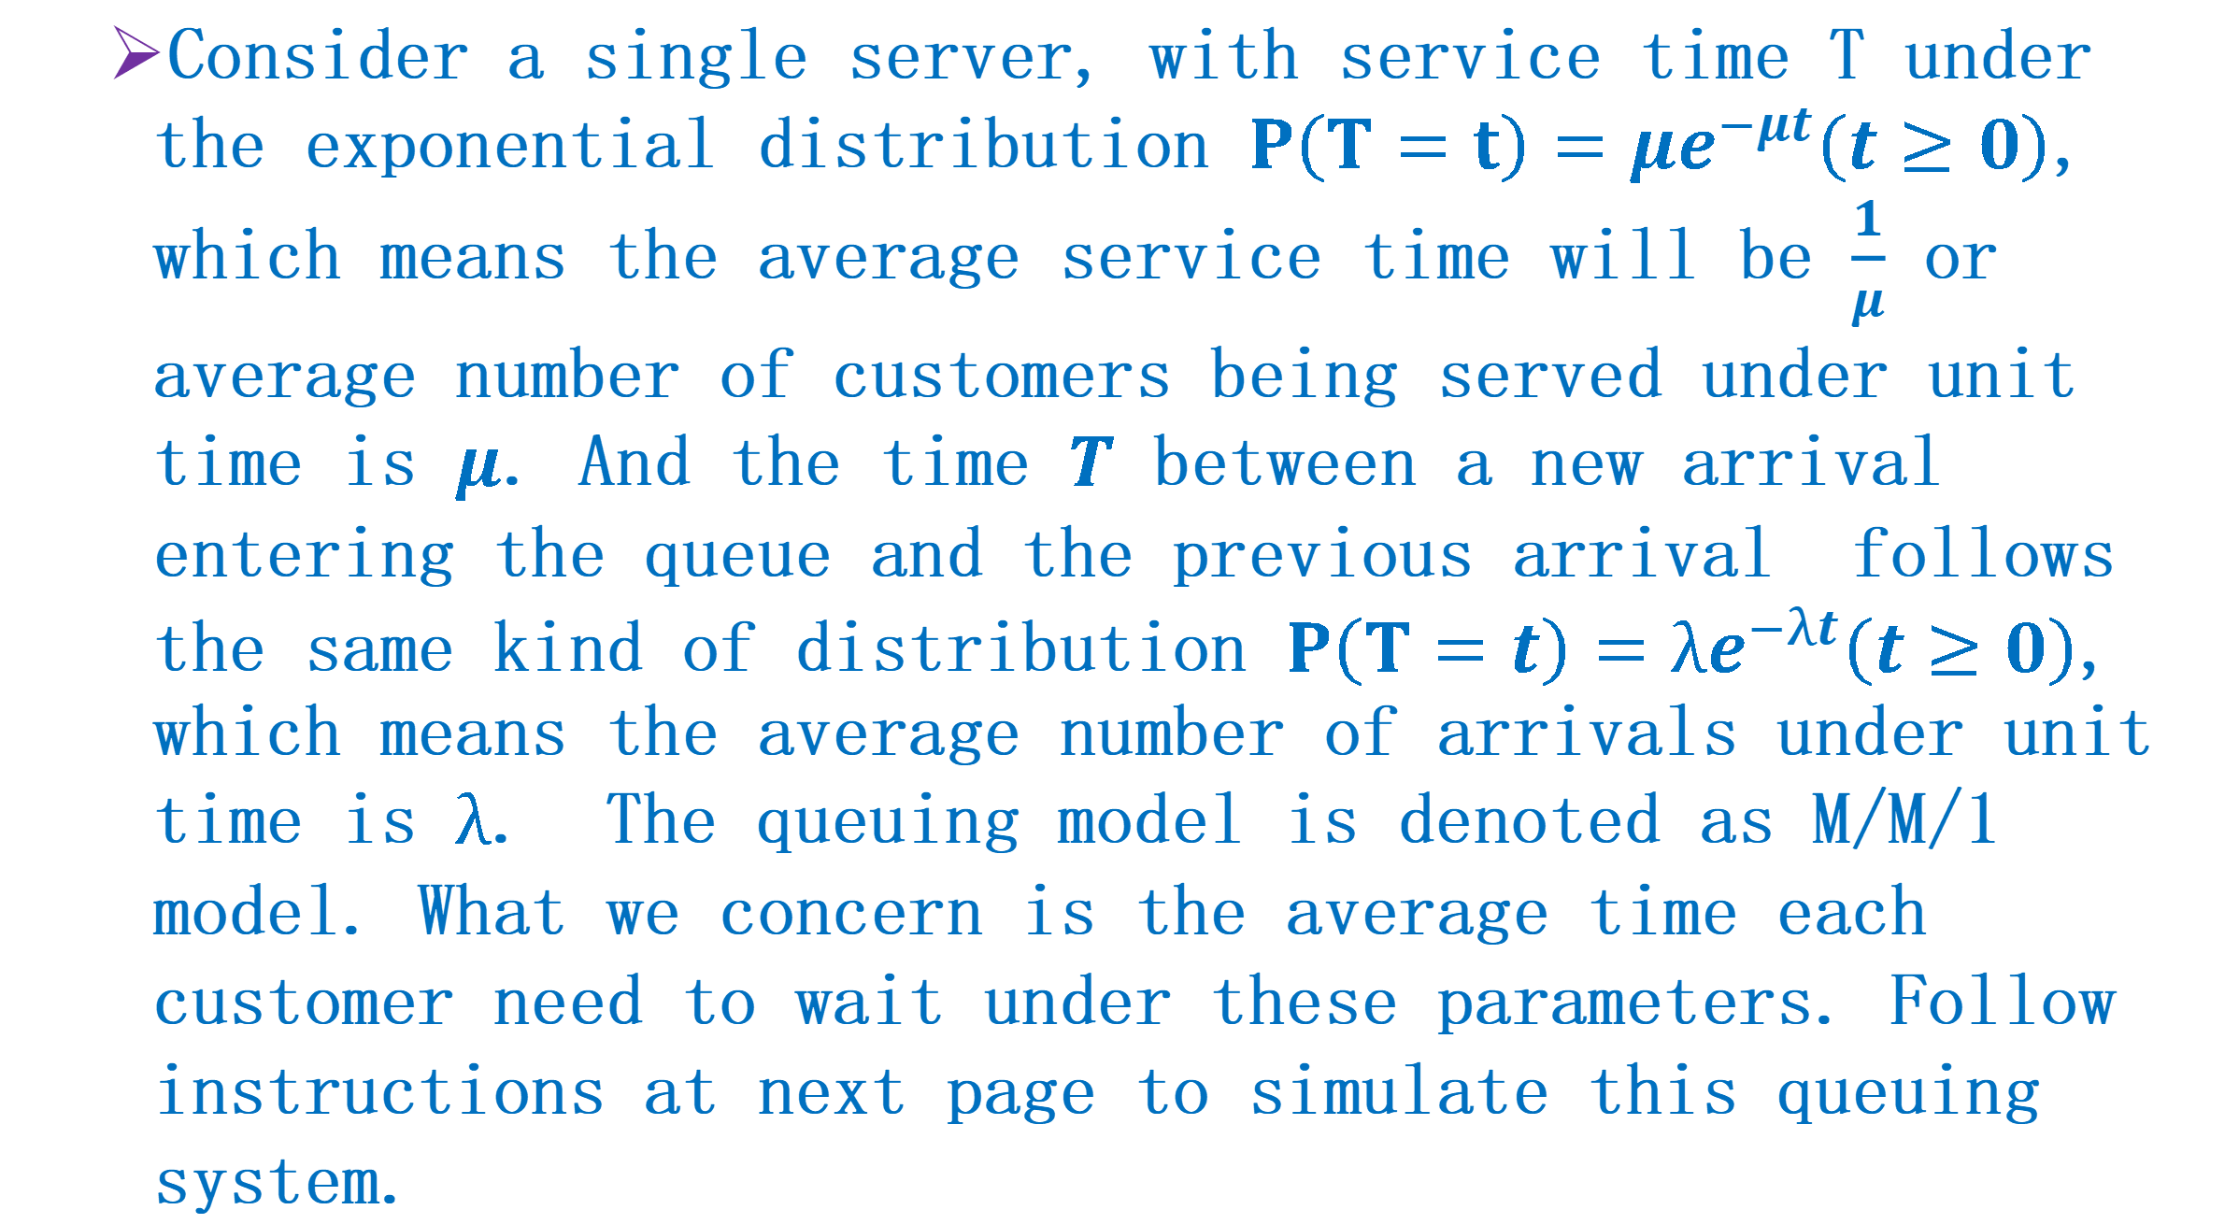
Q4: Queuing Model Simulation-III
Consider a single server, with service time T under the exponential distribution $P\left(T=t\right)=μe^{−μt}\left(t≥0\right)$, which means the average service time will be $\frac{1}{μ}$ or average number of customers being served under unit time is $μ$. And the time $T$ between a new arrival entering the queue and the previous arrival follows the same kind of distribution $P\left(T=t\right)=λe^{−λt}\left(t≥0\right)$, which means the average number of arrivals under unit time is $λ$. The queuing model is denoted as M/M/1 model. What we concern is the average time each customer need to wait under these parameters. Follow instructions at next page to simulate this queuing system.

Slide 20
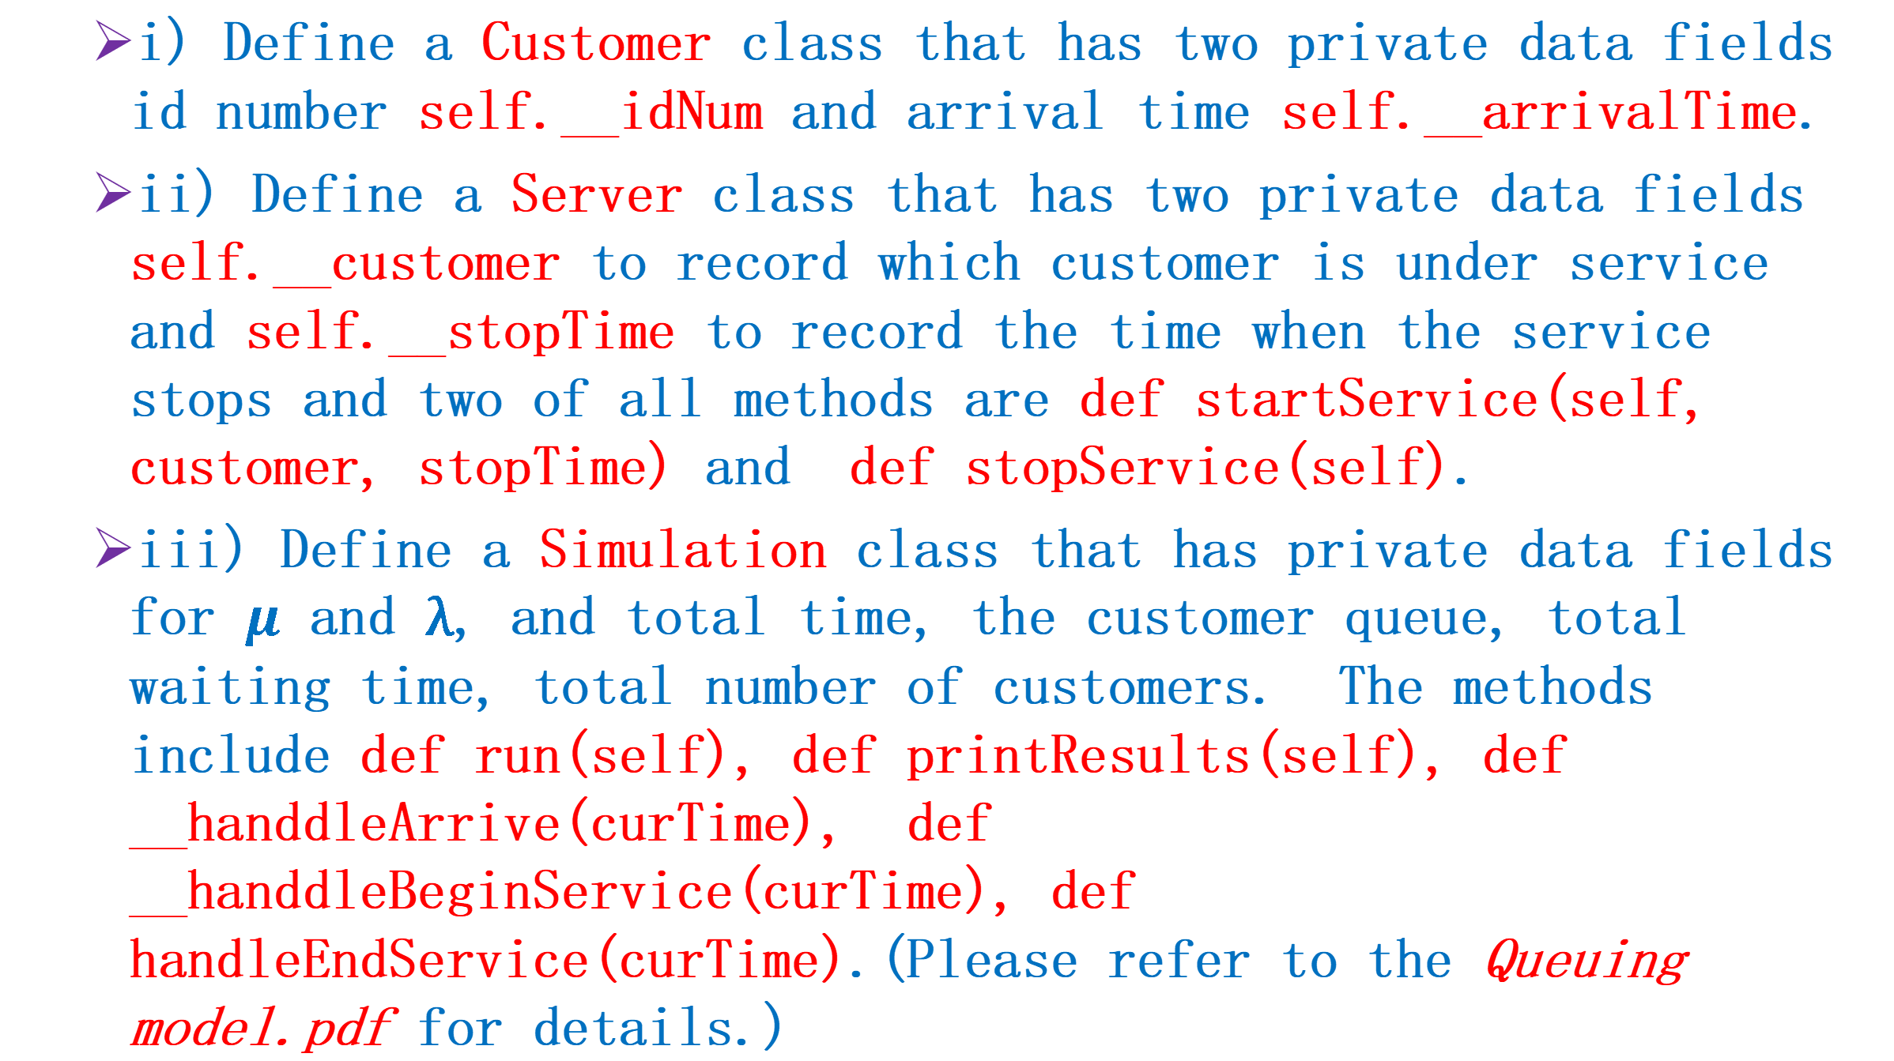
Q4: Queuing Model Simulation-IV
i) Define a Customer class that has two private data fields id number self.__idNum and arrival time self.__arrivalTime.
ii) Define a Server class that has two private data fields self.__customer to record which customer is under service and self.__stopTime to record the time when the service stops and two of all methods are def startService(self, customer, stopTime) and def stopService(self).
iii) Define a Simulation class that has private data fields for $μ$ and λ, and total time, the customer queue, total waiting time, total number of customers. The methods include def run(self), def printResults(self), def __handdleArrive(curTime), def __handdleBeginService(curTime), def handleEndService(curTime).(Please refer to the Queuing model.pdf for details.)

Slide 21
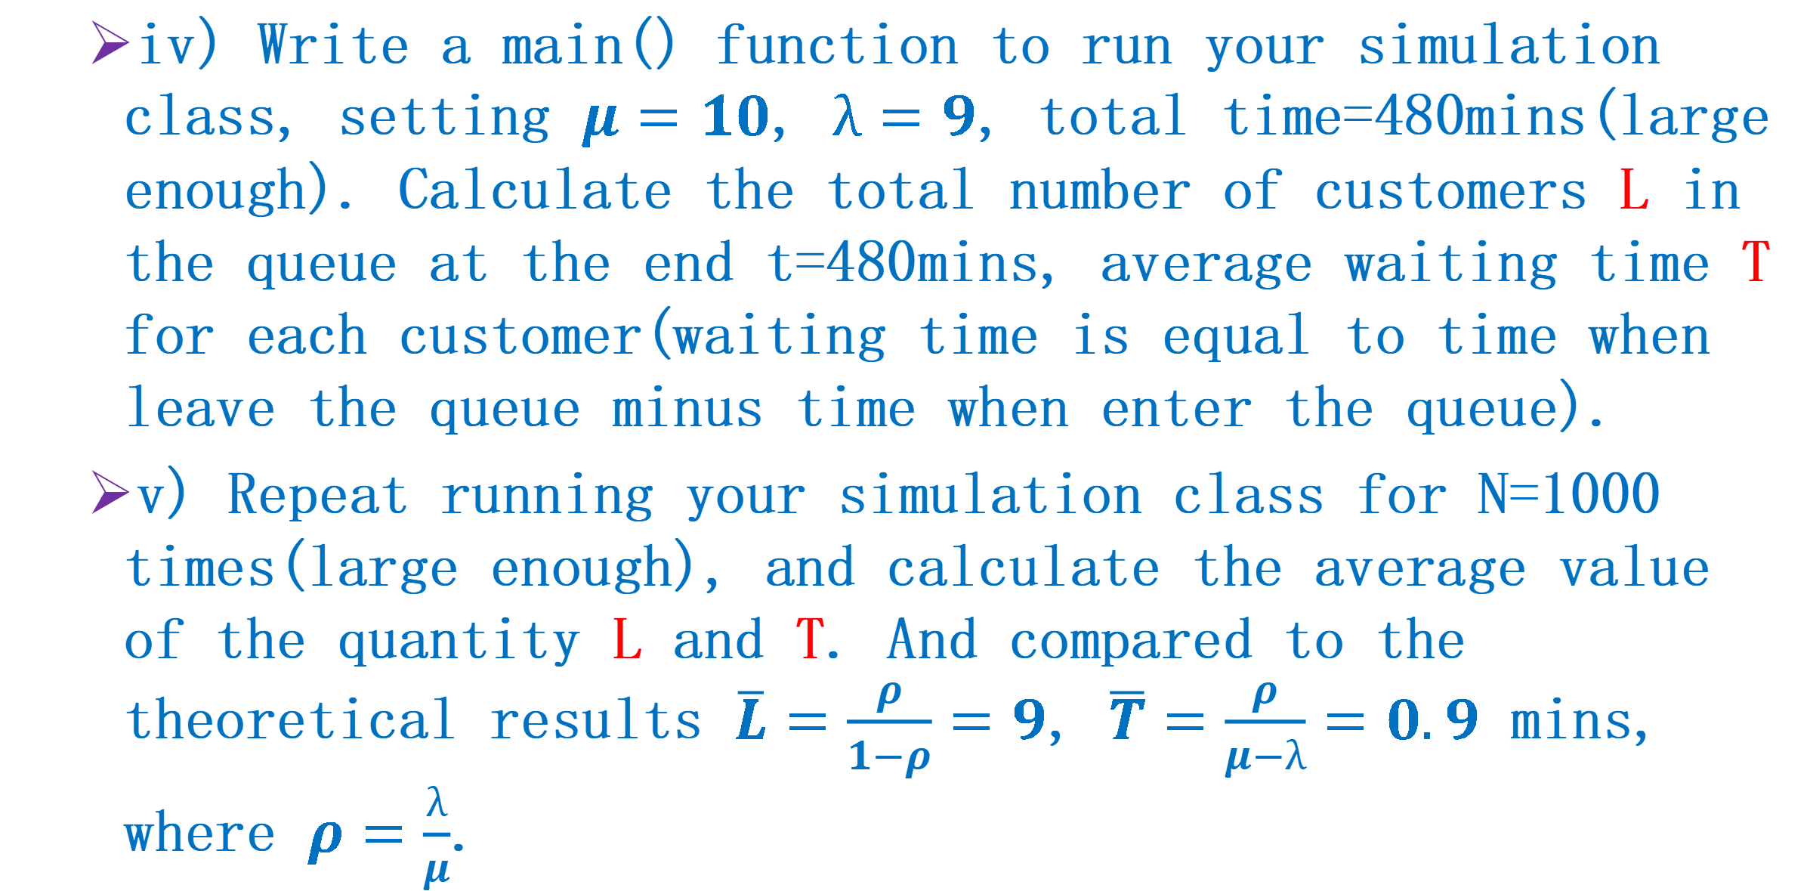
Q4: Queuing Model Simulation-V
iv) Write a main() function to run your simulation class, setting $μ=10$, $λ=9$, total time=480mins(large enough). Calculate the total number of customers L in the queue at the end t=480mins, average waiting time T for each customer(waiting time is equal to time when leave the queue minus time when enter the queue).
v) Repeat running your simulation class for N=1000 times(large enough), and calculate the average value of the quantity L and T. And compared to the theoretical results $\overline{L}=\frac{ρ}{1−ρ}=9$, $\overline{T}=\frac{ρ}{μ−λ}=0.9$ mins, where $ρ=\frac{λ}{μ}$.

Slide 22
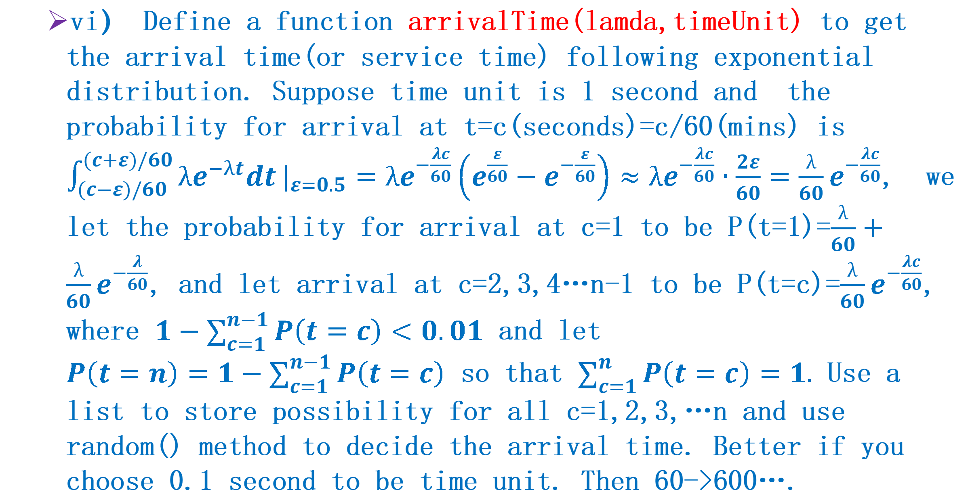
Q4: Queuing Model Simulation-VI
vi） Define a function arrivalTime(lamda,timeUnit) to get the arrival time(or service time) following exponential distribution. Suppose time unit is 1 second and the probability for arrival at t=c(seconds)=c/60(mins) is $\int_{(c−ε)/60}^{(c+ε)/60}{λe^{−λt}dt}|_{ε=0.5}=λe^{−\frac{λc}{60}}\left(e^{\frac{ε}{60}}−e^{−\frac{ε}{60}}\right)≈λe^{−\frac{λc}{60}}∙\frac{2ε}{60}=\frac{λ}{60}e^{−\frac{λc}{60}}$, we let the probability for arrival at c=1 to be P(t=1)=$\frac{λ}{60}+\frac{λ}{60}e^{−\frac{λ}{60}}$, and let arrival at c=2,3,4…n-1 to be P(t=c)=$\frac{λ}{60}e^{−\frac{λc}{60}}$, where $1−\sum_{c=1}^{n−1}{P\left(t=c\right)}<0.01$ and let $P\left(t=n\right)=1−\sum_{c=1}^{n−1}{P\left(t=c\right)}$ so that $\sum_{c=1}^{n}{P\left(t=c\right)}=1.$ Use a list to store possibility for all c=1,2,3,…n and use random() method to decide the arrival time. Better if you choose 0.1 second to be time unit. Then 60->600….

Slide 23
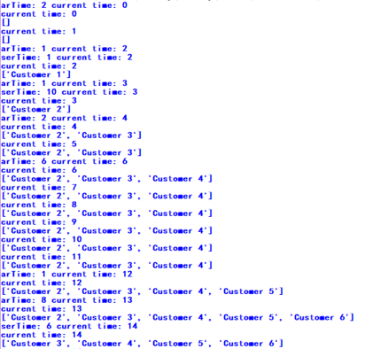
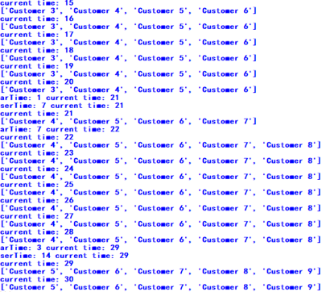
Q4: Queuing Model Simulation-VII
Sample Run: timeUnit =1 second, run totally for 30 seconds, print out the queue for each time. In this case, the arrival time generated is 2,1,1,2,6,1,8,1,7,3(s), which means there are customers arriving at 2, 3, 4, 6, 12, 13, 21, 22, 29(s), the service time generated is 1,10,6,7,14, which means Customer1 is served at 2s and leaves at 3s, …

Slide 24
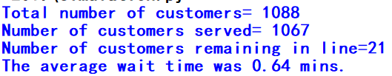

Q4: Queuing Model Simulation-VIII
Sample Run: timeUnit =0.1 second, run totally for 120 mins(120*600 seconds)(it should be longer to satisfy the assumption for theoretical result(t->∞)), print out the length of the queue at 120 mins, and the average waiting time for this simulation.
Trial 1
Trial 2
Sample Run: Repeat the above process for 100 times(it should be a lot more but it is really time consuming) and average the results.

